Slide 1
ECE 313: PROBABILITY WITH ENGINEERING APPLICATIONS
Spring 2023
Prof. Eric Chitambar
Lecture 2

Slide 2
The goal of this course is to introduce the mathematical framework and techniques for modeling and analyzing situations that involve uncertainty.
This framework is known as probability theory.

Slide 3

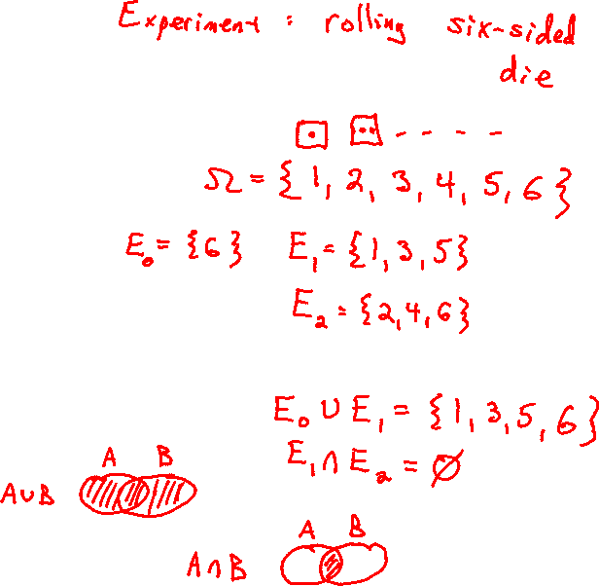
Some Basic Set Theory

Slide 4
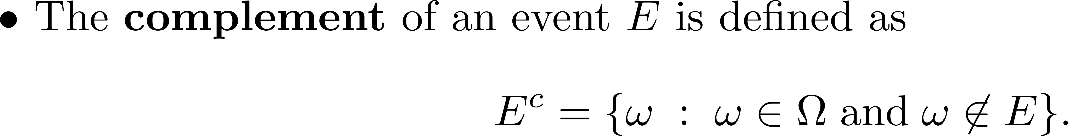
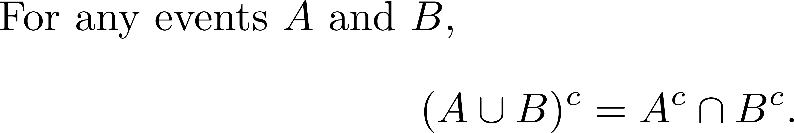
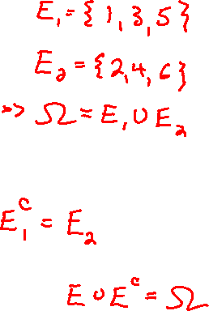
Some Basic Terminology

Slide 5











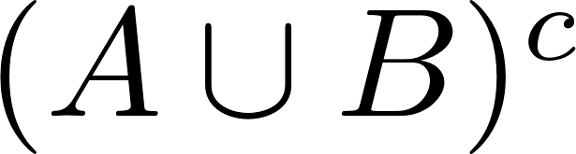

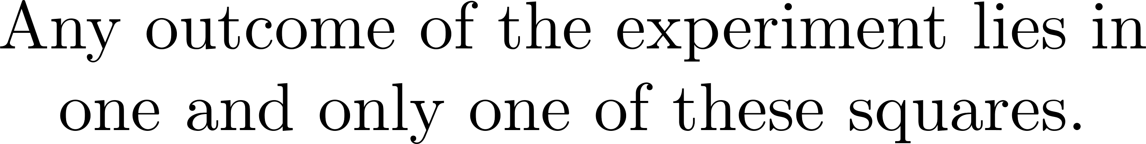


Proof of De Morgan’s using Karnaugh Maps

Slide 6
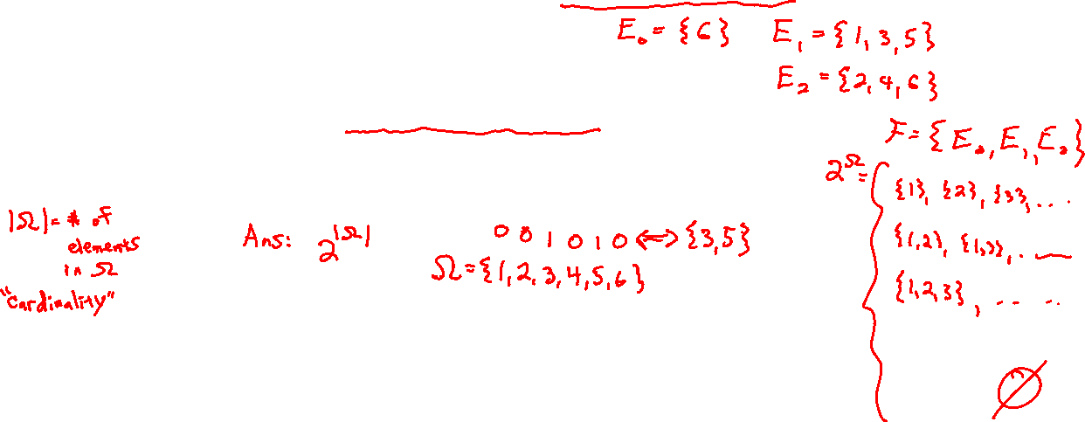
Some Basic Terminology

Slide 7

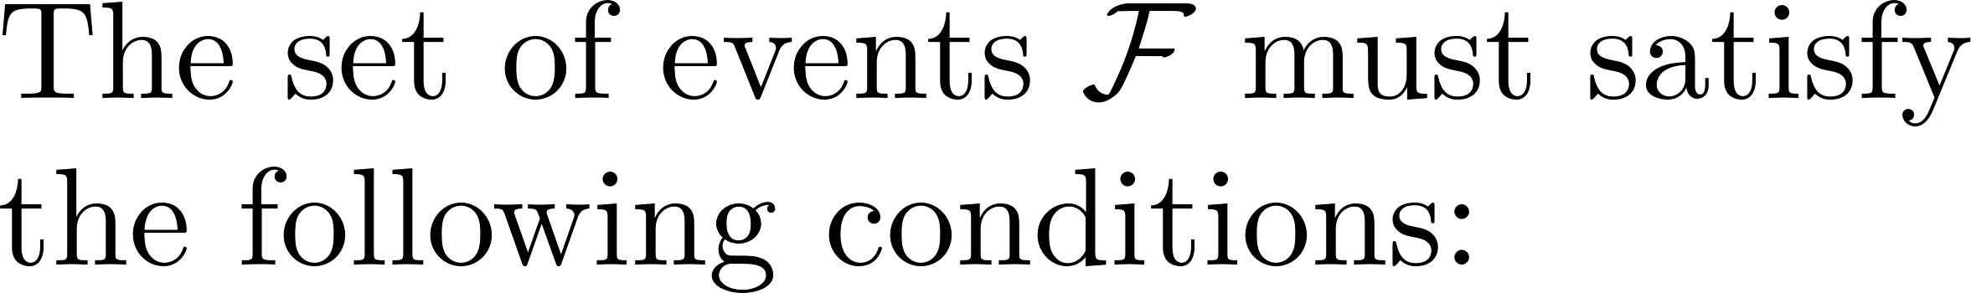

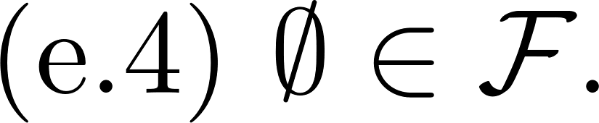
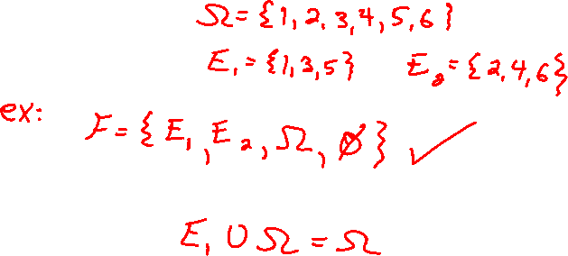
Axioms of a Probability Space

Slide 8

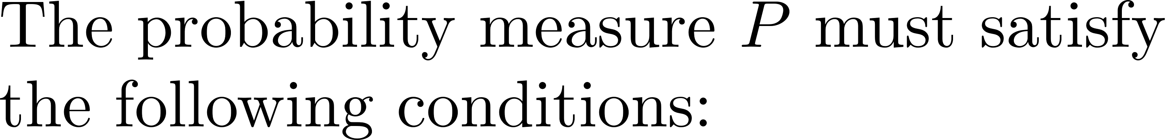

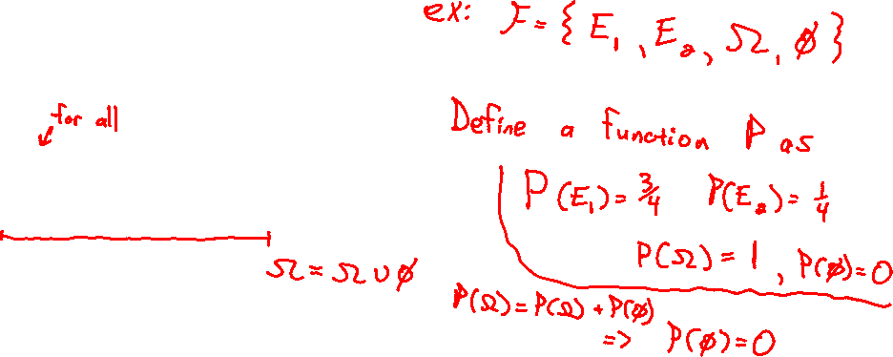
Axioms of a Probability Space

Slide 9
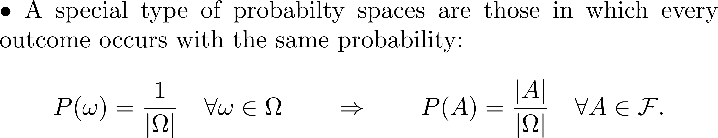
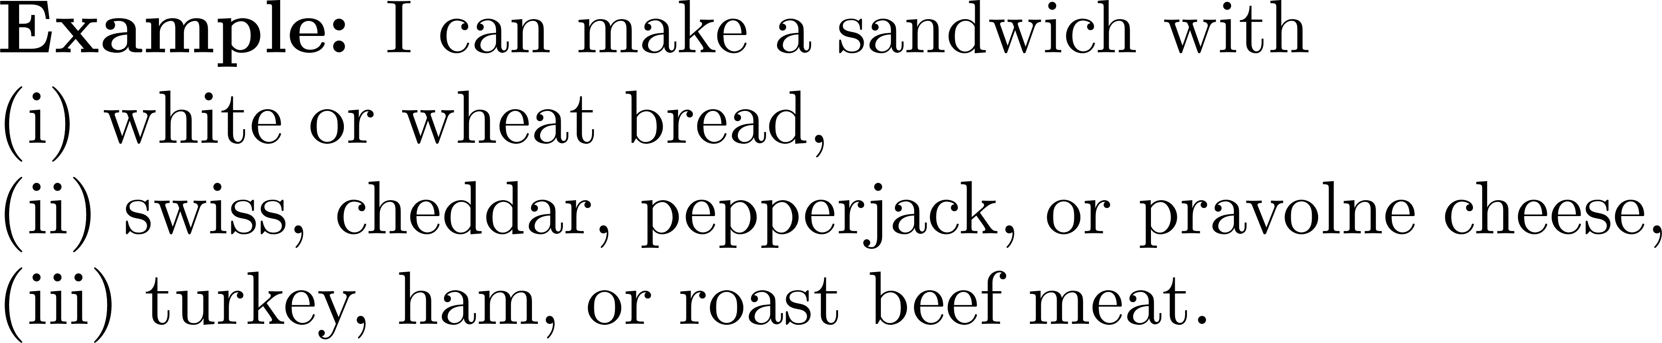

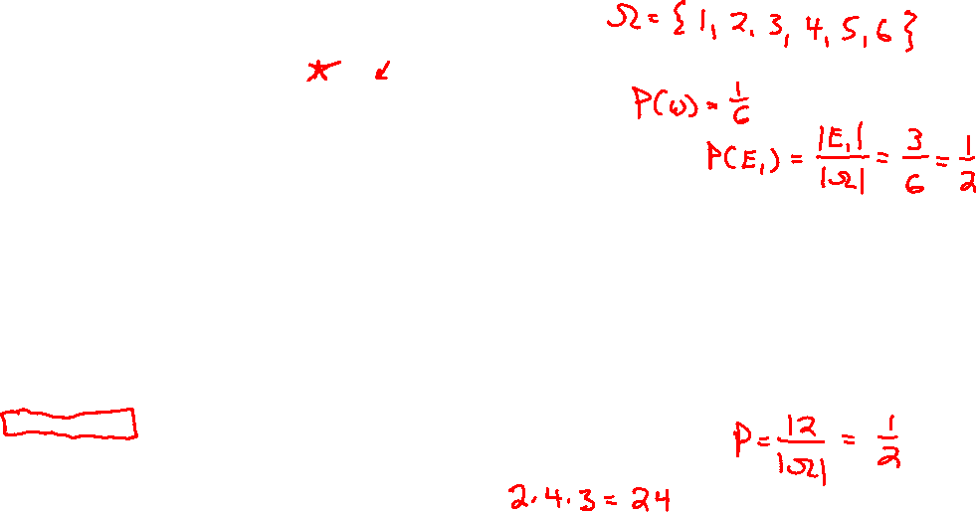
Experiments with Equiprobable Events

Slide 10
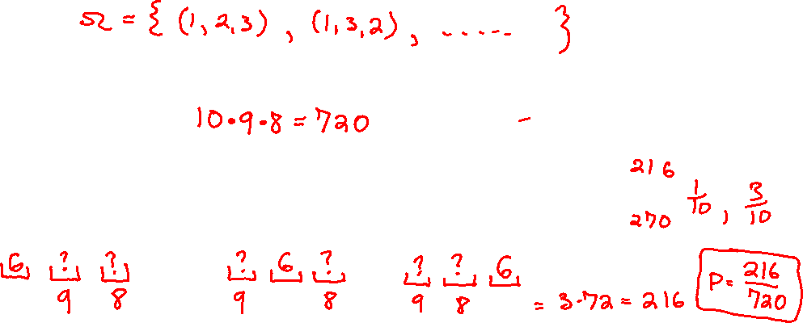
Example Problem

